Slide 1
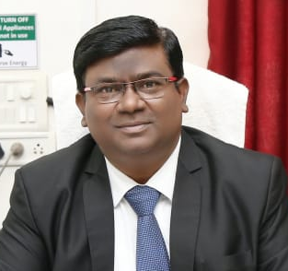
Pravin D. Ukey
Academic Incharge
& Head of Department
Department of Processing & Food Engineering
Dr. D. Y. Patil College of Agricultural Engineering and Technology, Talsande, Kolhapur
EDUCATION
M. Tech. (APE)
Mahatma Phule Krishi Vidyapeeth
Rahuri (Maharashtra)
B. Tech.(Ag. Engg.)
Dr. Panjabrao Deshmukh Krishi Vidyapeeth, Akola
EXPERIENCE
Academic Incharge
Head of Department
Dr. D. Y. Patil CAET, Talsande, Kolhapur 18 Y 09 M
(25th Nov., 2003 to till date)
COURSES TAUGHT
Thermodynamics
Heat & Mass Transfer
P.H.E. of Cereals, Pulses & Oilseeds
Engg. Properties of Biological Materials & Food Quality
Drying of Farm Crops
Seed Process Engineering
CONTACT
+919923671433
pravin.ukey@rediffmail.com
pravin.ukey1433@gmail.com
DOB: 1st May, 1977
STRENGTHS
Sincerity and Punctuality
Devoted to Hard Work
Strong Teaching & Motivational Skill
PUBLICATIONS
Scientific (Referred) - 14
Technical - 08
Popular articles - 06
Books /Booklet - 03
MEMBERSHIPS
Life Member - Indian Society of Agricultural Engineers (ISAE)
Member of Institution of Engineers (India), (MIE)
ACHIEVEMENTS
Qualified National Eligibility Test in September 2010
BEST ENGINEER AWARD (2021) by The Institution of Engineers (India) Kolhapur Local Centre on the occasion of 54th Engineers day on 15th September, 2021
BEST FACULTY AWARD (2019) by VDGOOD Professional Association in the 2nd International Scientist Awards on Engineering, Science & Medicine on 16 & 17 Nov 2019, Visakhapatnam, India
  BEST POSTER PRESENTATION AWARD in National Seminar on Recent Trends in Plant Science and Agricultural Research, organized by Zonal Agricultural Research Station (MPKV), Solapur on 11-12 Jan. 2018.
  Successfully Organized Two Days Hands on Training cum Workshop on “Preparation of Ginger Powder”.
  Established and Successfully working Modified Zero Energy Cool Chamber for D. Y. Patil Campus, Talsande.
  Established and Successfully working Solar Tunnel Dryer for D. Y. Patil Campus, Talsande.
  Highest Feedback in teaching given by students in last 5 years.
  Worked as Subject Expert for development of curriculum for “Diploma in Agriculture Engineering” for MSBTE
  Worked as Organizing Secretary for Successfully Organization of Poster Presentation Competition on “AGRICULTURE & TECHNOLOGY” on 18th February, 2020.
  Books Published
  1) Exam Planner – B. Tech. (Agricultural Engineering) 2014
  2) Exam Planner – B. Sc. (Agriculture) 2015

